Slide 1
Local Roadmap to Community Resilience
[Community Name]
Kickoff Meeting
[Meeting Date]
[Meeting Location/Link]

Slide 2
Housekeeping [for an online meeting]
Please add your name and email to the chat.
Request to record our meeting [if recording].
Please actively participate and ask questions!
Please explain any acronyms you use.
If you have background noise, please use the mute function.

Slide 3
Housekeeping [for an in-person meeting]
Please sign in on the sheet provided.
Please actively participate and ask questions!
Please explain any acronyms you use.
Please try to limit distractions by quieting your phone, if possible.
Restrooms
Safety

Slide 4
Welcome and Introductions

Slide 5

Introductions
Name
Organization/Agency
Why have you decided to be involved with this project?

Slide 6
Agenda Overview

Slide 7
Agenda
Welcome and Introductions
Agenda Overview
Meeting Purpose and Outcomes
Local Roadmaps to Community Resilience Overview
  Background
  Project Team Roles and Responsibilities
  Local Roadmap to Community Resilience Milestones and Activities
  Local Roadmap to Community Resilience Product
Proposed Workshop Schedule
Next Steps
Questions

Slide 8
Meeting Purpose and Outcomes

Slide 9
Meeting Purpose and Outcomes
Understand the purpose of meetings and activities to complete the Local Roadmap to Community Resilience project.
Define clear roles and responsibilities of the project team; this may include stakeholders from the public, private, and nonprofit sectors in the community.
Understand the contents of the Local Roadmap to Community Resilience Toolkit and resources.
Identify the project’s next steps, including meeting/workshop dates and locations.
Share any additional community data for the identified community.
Address any questions from participants.

Slide 10
Local Roadmap to
Community Resilience Overview

Slide 11
Roadmap Background
Process developed for communities to become more resilient by understanding risks through a self-assessment process
Includes the identification of hazards, exposure, vulnerabilities, and capacities
Action-oriented process, moving a community from understanding risk to identifying preparedness and risk reduction actions (projects)
Leverages an International Federation of Red Cross process
Four key milestones to complete the Local Roadmap to Community Resilience

Slide 12
Roadmap Project Team
[Project Leader’s Name/Organization]
[Provides project oversight, guidance, and direction]
Community Representatives
Provide key subject matter expertise; opportunity for grant funding
[Name/Organization]
[Describe role]
Local Government
Integration with existing projects or programs; oppurtunity for grant funding

Slide 13
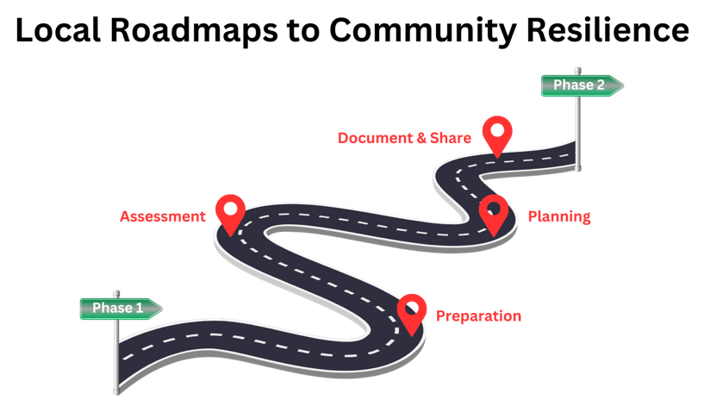
Four Milestones to Roadmap Completion

Slide 14
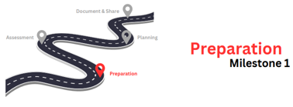
Preparation
Completed:
Choose your community of focus (Census tract level)
Introductions of the project team, today’s kickoff meeting
In Progress:
Gather existing data to include hazards, social vulnerability, climate change impacts, etc.
Data is being collected in a Geographic Information System (GIS) platform specifically for this project (available to all)
Participate in Community Resilience Training

Slide 15
Community Identified
What community was chosen?
Why was this community chosen?
[Insert Census Maps from CJEST]

Slide 16
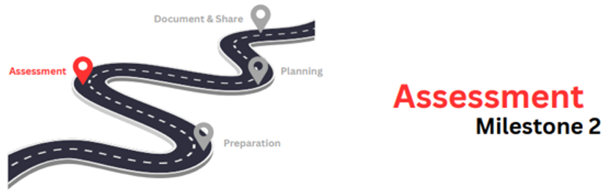
Assessment
Participate in the Community Assessment Workshop (in-person or virtual, 4 hours)
Workshop activities:
  Review of community profile and data
  Identify community risks (hazards/exposures/vulnerability/capacity)
  Prioritize hazards and identify how they affect the community

Slide 17
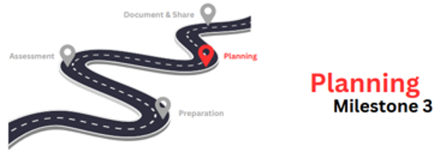
Planning
Participate in the Community Action
Planning Workshop (in-person or virtual, 4 hours)
Workshop activities:
  Envision what the community wants to achieve in the future
  Identify potential solutions/projects to address top hazards and funding needs
After the Workshop, a Draft Roadmap will be developed and shared with project team.
Project team will complete feedback via an online survey and participate in a virtual feedback meeting.

Slide 18
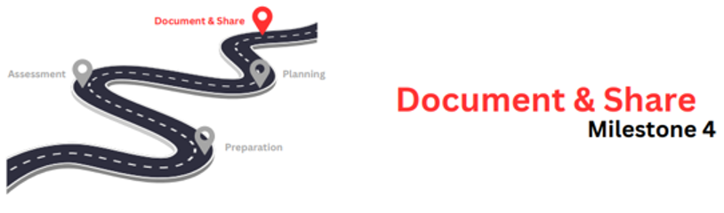
Document & Share
Develop a Draft Local Roadmap to Community Resilience.
Hold a Listening Session to review the Draft Local Roadmap to Community Resilience.
A Final Local Roadmap to Community Resilience will be approved by the project team.

Slide 19

Final Roadmap
Collaboratively developed final deliverable that identifies your community priorities.
Contents will include:
Cover Page
Handling Instructions
Stakeholder List
Project Narrative
Community Profile (GIS data and your feedback)
Strategic Planning Matrix (strategy and projects to address needs)
Conclusion
Appendices

Slide 20
Proposed Meeting Schedule

Slide 21
Meeting Snapshot and Timeline
MONTH YEAR
Kickoff Meeting
MONTH YEAR
Community Resilience Training (“Primer”)
MONTH YEAR
Community Action Planning Workshop
MONTH YEAR
Community Assessment Workshop
MONTH YEAR
Listening Session for Feedback on the Draft Roadmap
DONE!
Recorded Session
[In-Person or Virtual]
4 hours
[In-Person or Virtual]
4 hours
[In-Person or Virtual]
1-2 hours

Slide 22
Next Steps

Slide 23
Schedule Meetings and Locations
Meeting | Proposed Dates and Location
Kickoff Meeting | [Insert Date Completed]
Community Resilience Training (“Primer”) | Recorded Session
Community Assessment Workshop (4 hours) | [Insert Possible Date/Location]
Community Action Planning Workshop (4 hours) | [Insert Possible Date/Location]
Listening Session for Feedback on the Draft Roadmap (1-2 hours) | *can be scheduled TBD

Slide 24
Additional Next Steps
Secure meeting locations, if needed.
Community partners and other project team members will share any additional community data (GIS or community profile).
Invite additional stakeholders and community organizations,
as needed.

Slide 25

Contact Information
[Organization]
[Name]
[Role]
[Email address]
[Phone number]
[Organization]
[Name]
[Role]
[Email address]
[Phone number]

Slide 26

Questions?

Slide 27
Thank You!

